Slide 1
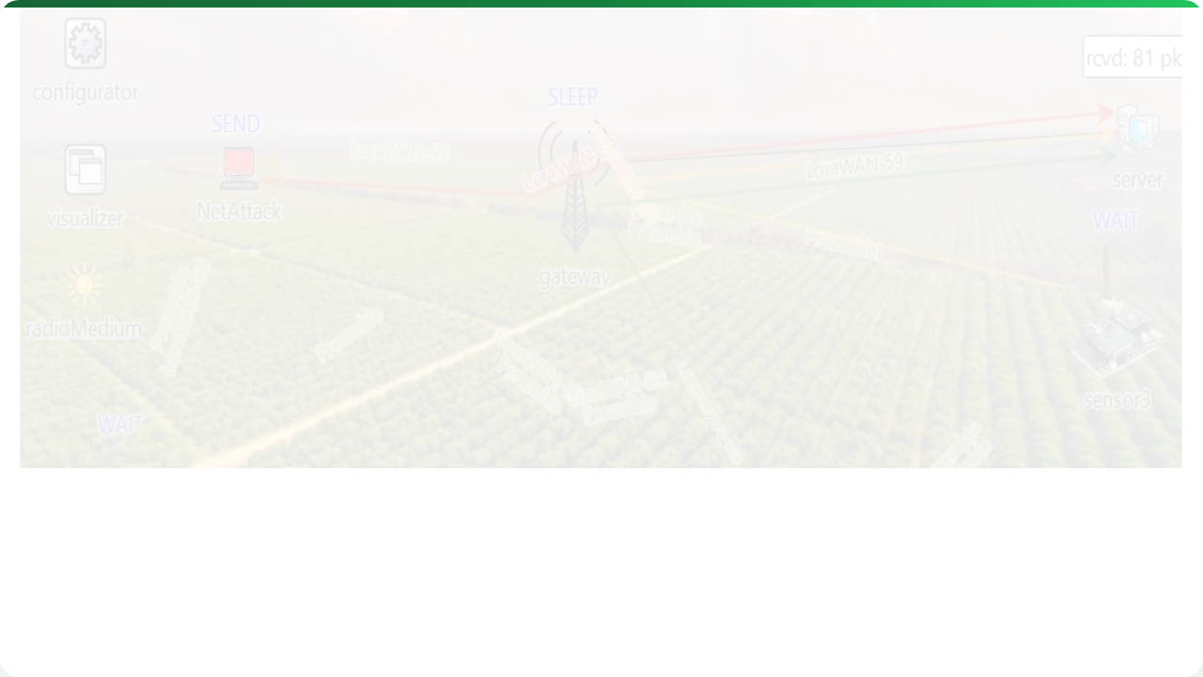



DATA COLLECTION & IOT IN PA
Lecture 7: Connecting the Farm
AGE 418
Dr. Kadeghe Fue

Slide 2
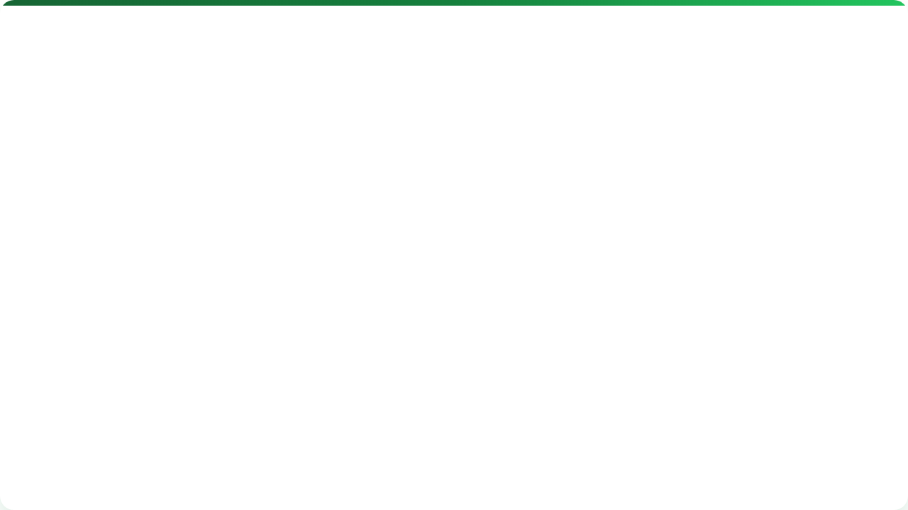



Lecture Roadmap
The Shift
Implementation
Evolution of Data Collection
Wireless Protocols (LoRaWAN)
Defining IoT in Agriculture
Case Studies (Weather/Soil)
The 4-Layer Architecture
Edge Computing & Challenges

Slide 3
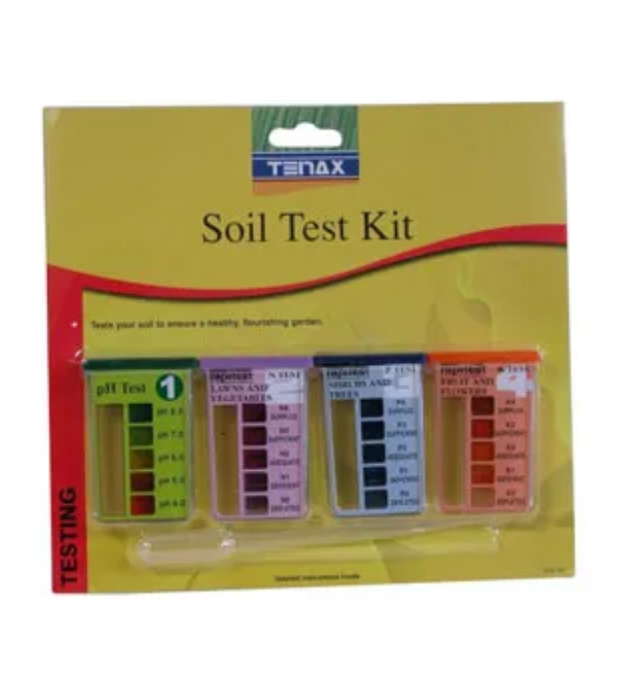
Evolution of Collection
From "Clipboards" to "Dashboards"
Manual (Past): Walking the field, writing in notebooks. Slow, prone to error, data lag.
Automated (Present): Sensors stream data 24/7. Instant access, alerts, historical trends.

Slide 4
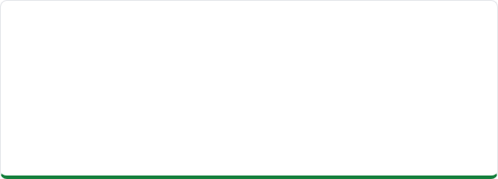
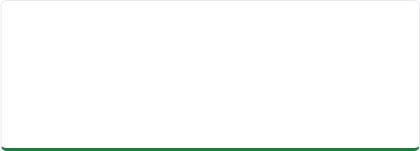

Why IoT? Real-Time Decisions
Reactive (Old)
Proactive (IoT)
"The crop looks wilted. I should have irrigated yesterday."
"Moisture is dropping below 30%. Pump turning ON automatically."

Slide 5
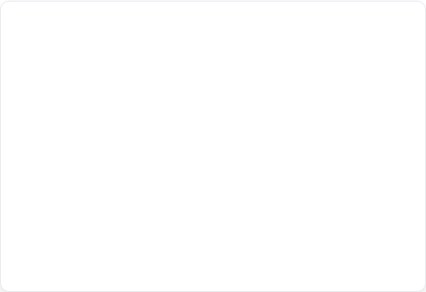
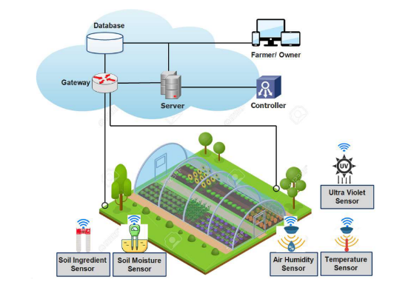
Definition: IoT in Agriculture
Internet of Things (IoT)
A network of physical objects ("things") embedded with sensors, software, and other technologies to connect and exchange data with other devices and systems over the Internet.
"Giving the field a voice."

Slide 6
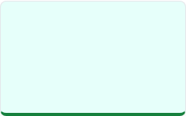
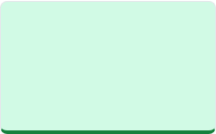


The 4-Layer Architecture
1. Perception
2. Network
3. Cloud
4. App
Sensors & Nodes
Gateway & Connectivity
Storage & Processing
User Interface

Slide 7

Layer 1: Perception Layer
The "Senses" of the farm.
Sensors: Collect data (Temp, Moisture, GPS, pH).
Actuators: Perform actions (Open valve, Turn on fan).
Nodes: The physical box containing the sensor, battery, and transmitter.

Slide 8
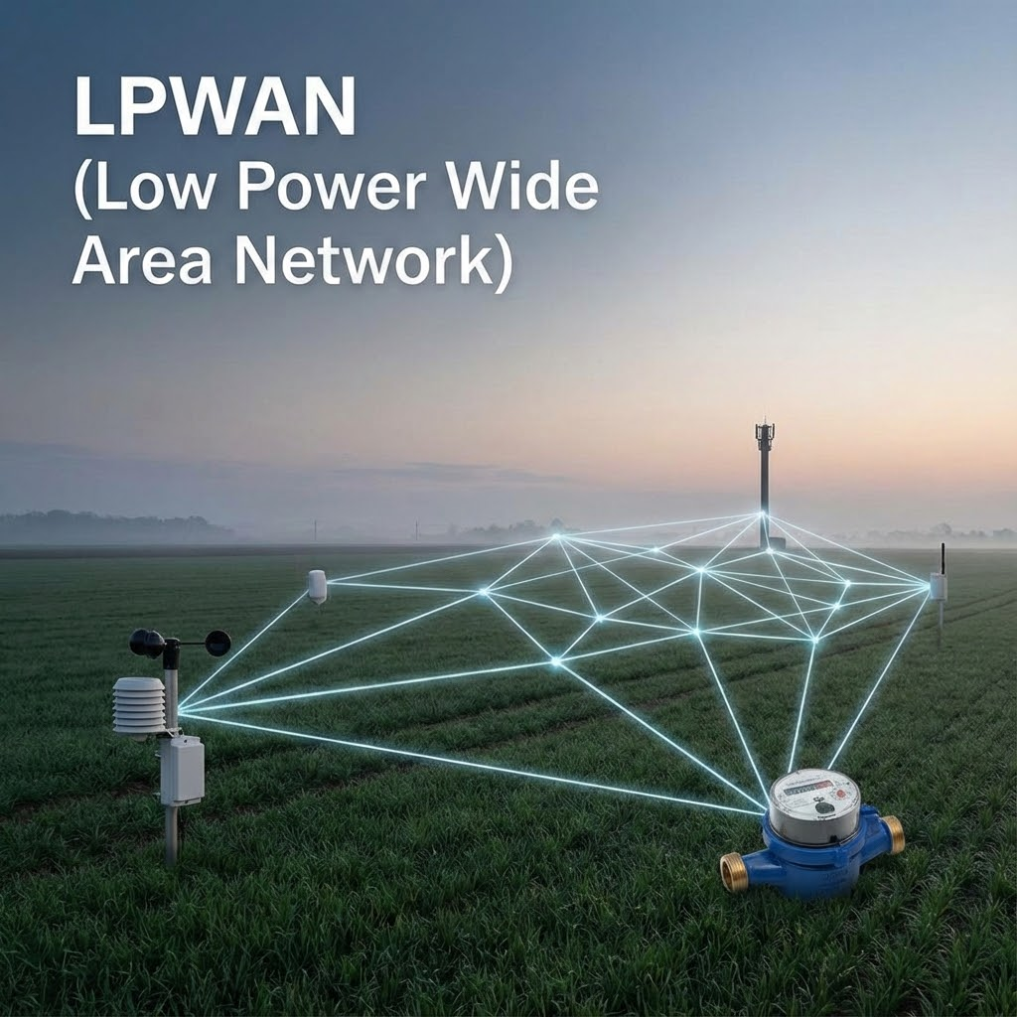
Layer 2: Network Layer
How data travels from the field to the internet. Agriculture has unique challenges:
Large Areas: WiFi range is too short (100m).
No Power: Devices run on batteries/solar.
Remote: 4G/5G might be weak or expensive.
Solution: LPWAN (Low Power Wide Area Network)

Slide 9


Wireless Protocols: Short Range
Bluetooth / BLE
Zigbee / Wi-Fi
Very short range (10m).
Short to Medium range (100m).
Use: Connecting a phone to a tractor display or handheld sensor.
Use: Greenhouse automation where power is available and sensors are dense.

Slide 10
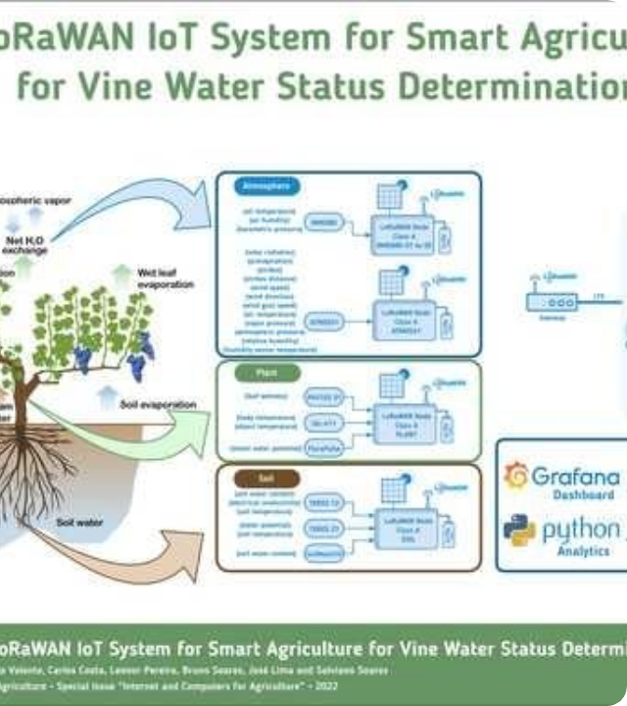
Long Range: LoRaWAN
Long Range Wide Area Network. The king of Ag IoT.
Range: 10km - 15km in open fields.
Power: Batteries last 5-10 years.
Cost: Free spectrum (ISM band). No monthly SIM card fees.

Slide 11
Protocol Comparison
Protocol | Range | Power Usage | Best For
Wi-Fi | Short | High | Video / High Data
Cellular (4G) | Anywhere | High | Gateways / Roaming
LoRaWAN | Long (15km) | Very Low | Soil Sensors / Weather

Slide 12

Layer 3: Cloud / Middleware
The "Brain". Where data is stored and processed.
Ingestion: Receiving millions of data packets.
Storage: Database (SQL/NoSQL).
Processing: Cleaning data, running models (e.g., Disease prediction algorithms).

Slide 13
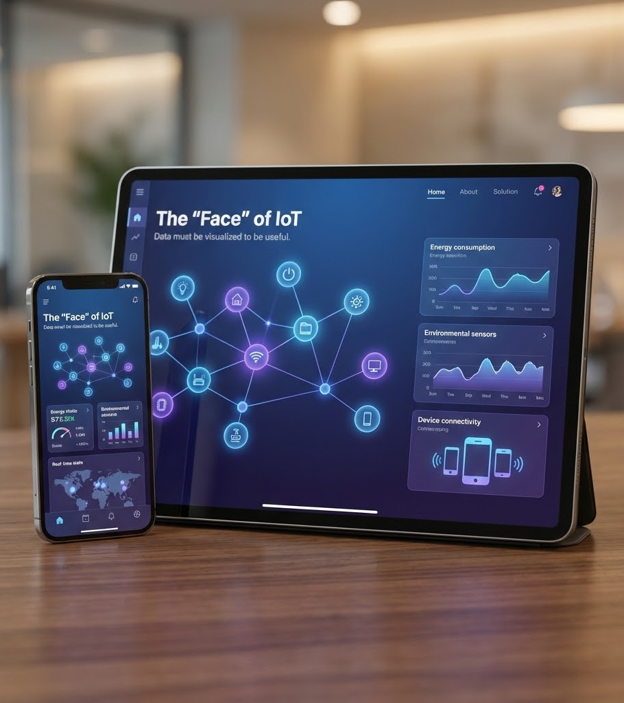
Layer 4: Application
The "Face" of IoT. Data must be visualized to be useful.
Dashboards: Graphs of moisture trends.
Alerts: SMS/Notification "Frost Warning: -1°C".
Automation: Turning pumps on/off.

Slide 14
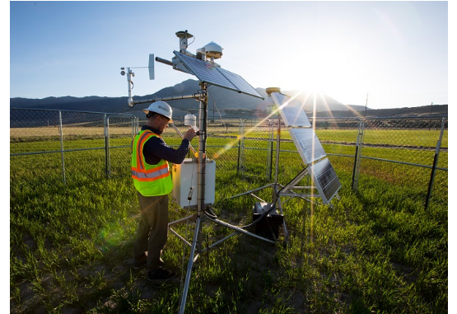
Case Study: Smart Weather Station
Hyper-local weather data is critical for pest models.
Sensors: Rain gauge, Anemometer, Pyranometer.
Power: Solar panel + Li-Ion battery.
Comms: Sends data every 15 mins via LoRaWAN to the farmhouse.

Slide 15
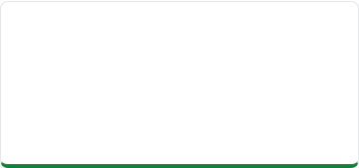
Case Study: Soil Moisture Network
Problem
Solution
Result
Variable soil types meant one irrigation schedule didn't fit all.
10 Capacitance probes buried at different depths across 3 zones.
Reduced water use by 20% by irrigating strictly based on root-zone demand.

Slide 16
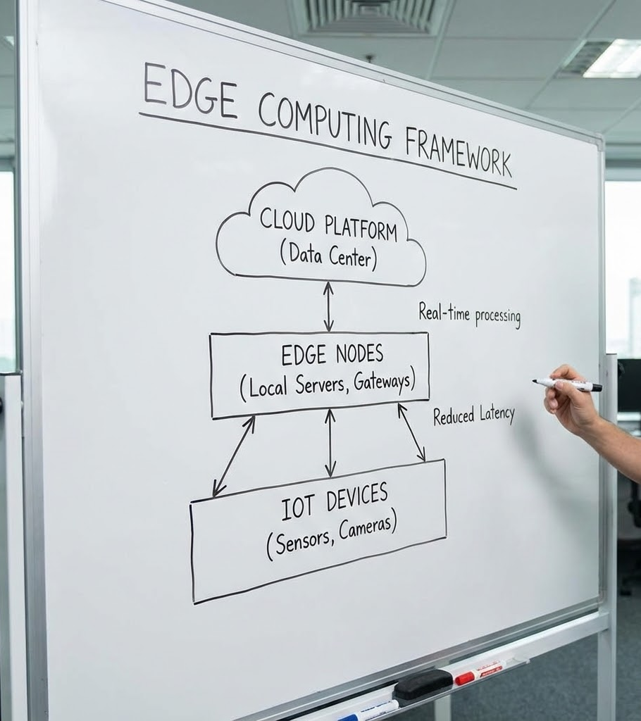
Edge Computing
Processing data at the Source.
Instead of sending all video data to the cloud (slow/expensive), the tractor processes the weed image instantly.
Benefit: Ultra-low latency (milliseconds) needed for spray nozzles.
Bandwidth: Saves data costs.

Slide 17





Challenges in Ag IoT
Power
Connectivity
Security
Devices must survive seasons without battery changes.
Rural "Dead Zones" limit cellular based devices.
Protecting farm data from hacks or unauthorized access.

Slide 18


Lecture Summary
Architecture
Connectivity
4 Layers: Perception (Sensors), Network (LoRa), Cloud (Data), App (User).
LoRaWAN is the dominant protocol for Ag due to range and power efficiency.
Next Class: Lecture 8 - Control Systems & VRT

Slide 19

Questions?
Dr. Kadeghe Fue | AGE 418
Sokoine University of Agriculture

